Slide 1
Health Insurance Marketplace
All Blue 2014 Workshops
1

Slide 2

Agenda
2014 Marketplace Performance
  Financial Assistance
  Impact on Uninsured
  Individual Market Demographics
  Membership by Service Area
  Membership by Previous Coverage
  Membership by Network/Metallic Level
Provider Questions
Education Campaigns
  Marketplace Resources
  Know Then Go
  Shop Smart
What to Expect in 2015
Health Insurance Marketplace > Agenda
2

Slide 3
2014 Marketplace Performance
Health Insurance Marketplace
1

Slide 4
Marketplace Performance in 2014
Health Insurance Marketplace
BlueCross BlueShield of Tennessee data¹ shows 129,948 Tennesseans selected a Marketplace plan as of May 27, 2014.
An estimated 88 percent of the Marketplace plans issued in Tennessee are BlueCross plans.
BlueCross had the 12th largest Marketplace enrollment in the U.S. among states with a federal Marketplace.
Thousands of previously uninsured Tennesseans now have the peace of mind that goes along with health coverage.
  ¹ BCBST data as of May 27, 2014
Health Insurance Marketplace > 2014 Marketplace Performance
10
Notes:
Key Points:
BlueCross had a very strong performance in the first year of the Marketplace
We were able to provide comprehensive, affordable coverage to thousands of Tennesseans who were previously uninsured

Slide 5
Marketplace Performance – Financial Assistance
Health Insurance Marketplace
80%
$265
64%
of our Marketplace subscribers receive a subsidy
average monthly subsidy
of our Marketplace members have a Cost Share Reduction plan
Subsidies were critical to a member’s ability to afford a health plan purchase.
Health Insurance Marketplace > Marketplace Performance
11
Source: Facets 4/28/14
Notes:
Key Points:
Quite a few people (80% of our Marketplace members) got help paying their monthly premium
On average, they got about $265 in support per month
And 64% got extra support with cost sharing reduction plans – meaning, the amount of copays, coinsurance and deductibles paid were lower than their actual plan design
These subsidies were critical to a member’s ability to afford health insurance.

Slide 6

Individual Market – Previously Uninsured
Health Insurance Marketplace
Estimated Percent of Uninsured Enrolled
NATIONAL AVERAGE
13.6%
TENNESSEE
15.2%
RANK
19
BLUE CROSS PROJECTED MARKET SHARE
88.5%
BlueCross is largely responsible for the state’s Marketplace success with comprehensive coverage and affordable pricing.
Health Insurance Marketplace > Individual Market
12
Sources: HHS 3/11/14 and Kaiser Foundation
Notes:
Key Points:
Nationally, about 13.6% of people who were previously uninsured were able to purchase health insurance through the Marketplace.
In Tennessee, that number was higher. About 15.2% of previously uninsured Tennesseans now have health insurance.
BlueCross is largely responsible for the state’s Marketplace success (88.5% market share in the state)
Tennessee now ranks 19th for the number of uninsured individuals.

Slide 7

Individual Market – Demographics
Health Insurance Marketplace
12%
251,459
AGE 18-26
8%
ON & OFF MARKETPLACE
INDIVIDUAL MEMBERS
14%
AGE < 18
27%
AGE 27-34
AGE 55-64
54%
ARE FEMALE
49%
ARE 45-64
17%
AGE 35-44
BlueCross demographics are similar to national averages.
22%
AGE 45-54
Health Insurance Marketplace > Individual Market
13
Source: Market Strategy 5/27/14
Notes:
Key Points:
In looking at TOTAL enrollment for our individual market (ON and OFF Marketplace), we have more than 251,450 members.
Majority are female (54%), as women typically make the health care decisions for the household.
Most people (49%) who purchased were between the ages of 45 and 64; this skewed slightly older than we expected (factored in that more “young invicibles” would buy coverage), but we remain consistent with national averages

Slide 8
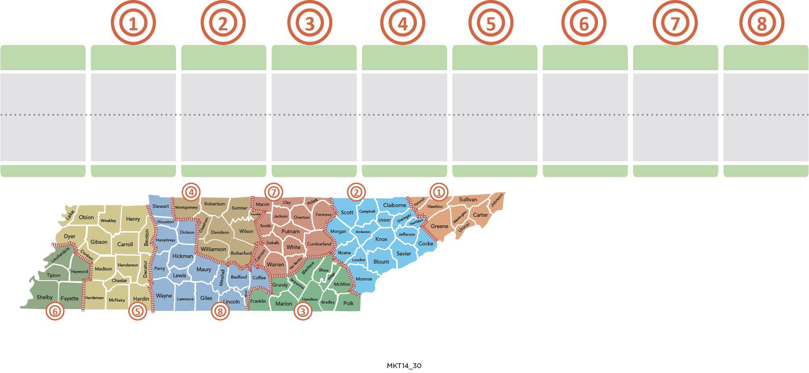
Individual Market – Membership by Service Area
Health Insurance Marketplace
EAST
KNOX.
CHATT.
NASH.
WEST
MEMPHIS
E. CTRL.
W. CTRL.
Members
12,232
27,681
18,967
53,361
12,075
22,633
9,764
12,750
Distribution
7%
16%
11%
31%
7%
13%
6%
8%
One out of three Marketplace members lives in the Nashville region.
1
Health Insurance Marketplace > Individual Market
14
Source: Facets 4/28/14
Notes:
Key Points:
Looking at Marketplace enrollment throughout the state, the Nashville/Middle Tennessee region 4 saw the most enrollment with 53,361 new members.
One out of three Marketplace members lives in the Nashville region

Slide 9
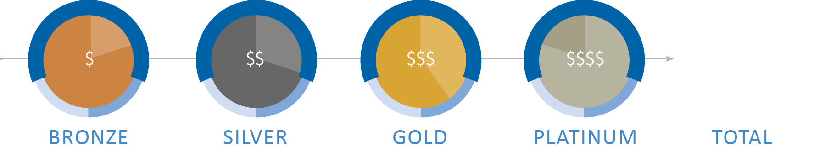
Individual Market – Membership by Network & Metal Level
Health Insurance Marketplace
BRONZE
SILVER
GOLD
PLATINUM
TOTAL
NETWORK E
9%
26%
2%
1%
38%
NETWORK S
12%
36%
5%
2%
55%
NETWORK P
1%
3%
2%
1%
7%
TOTAL
22%
66%
8%
4%
100%
66% of On- and Off-Marketplace members have selected a Silver plan.
55% bought Blue Network S and 38% bought Blue Network E.
1
Health Insurance Marketplace > Individual Market
16
Source: Facets 4/28/14
Notes:
Key Points:
66% of our On and Off Marketplace members chose a SILVER plan (Remember, Marketplace plans and traditional individual plans are the same.)
Why silver? A member had to choose a silver plan in order to take advantage of any subsidies available through the federal government.
Overall, our Blue Network S was the most popular, with 55% of consumers choosing it.
38% of our individual members chose Blue Network E.

Slide 10
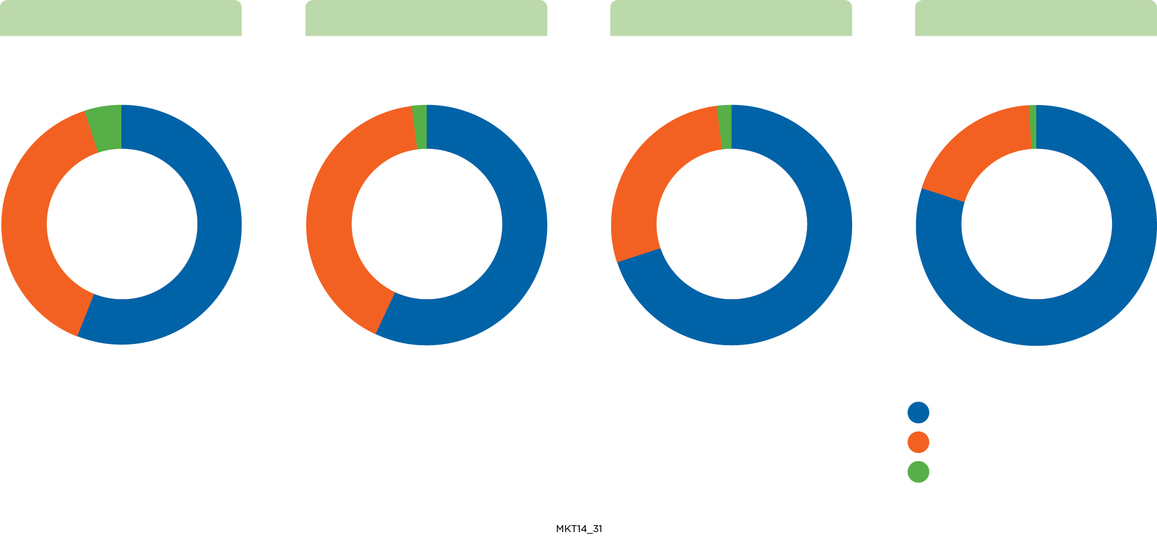




Network Membership in Blue Network E Service Areas
Health Insurance Marketplace
BlueCross members can purchase Marketplace plans that feature Blue Networks P, S or E.
Blue Network E is only available in four regions, and members must seek care from providers in any of those regions to receive “in-network” benefits. It is only available for plans sold through the Marketplace.
GREATER KNOXVILLE
CHATTANOOGA
GREATER NASHVILLE
GREATER MEMPHIS
5%
2%
2%
1%
39%
56%
41%
57%
27%
71%
19%
80%
BLUE NETWORK E
BLUE NETWORK S
BLUE NETWORK P
1
Health Insurance Marketplace > Individual Market
17
Source: Facets 4/28/14
Notes:
Key Points:
Remember, individual members were able to choose plans that feature Blue Networks P, S or E.
The only way they could select Blue Network E is if they purchased coverage through the Marketplace.
Blue Network E is only available in four regions of the state.
This slide shows you those regions, the strategic provider partner and how each network performed in those regions.

Slide 11
Common Provider Questions
Health Insurance Marketplace
1

Slide 12
Common Provider Questions
Health Insurance Marketplace
Out-Of-Network Benefits
All BlueCross plans include out-of-network benefits, as well as national and worldwide coverage through BlueCardSM, which applies when traveling outside Tennessee.
Providers will be reimbursed up to the standard Maximum Allowable Charge (MAC), which is based on a statewide standard out-of-network reimbursement schedule.
Blue Network E features the same medical emergency benefits as any other commercial network.
Out-of-network benefits are reimbursed the same way they are today.
Health Insurance Marketplace > Common Provider Questions
19
Notes:
Key Points:
We received a lot of questions about whether or not Marketplace plans or plans that featured Blue Network E featured out-of-network benefits. The short answer: YES, all our plans do.
Another key point, out-of-network benefits are reimbursed the same way they are today. No changes on our end from an administrative standpoint.

Slide 13
Common Provider Questions
Health Insurance Marketplace
Grace Period Requirements
Members who purchased a Marketplace plan through HealthCare.gov and received Advanced Premium Tax Credits now have a 90-day grace period if they don’t pay their monthly premiums.
Individuals must pay their first month’s premium before receiving any coverage.
BlueCross pays for claims processed during the initial 30 days of non-payment.
BlueCross uses multiple ways to communicate when someone is in the grace period (i.e., online notification, via phone service team, provider letter and notice on remittance advice).
Health Insurance Marketplace> Common Provider Questions
20
Notes:
Key Points:
The extended 90-grace period is part of the federal law. It is not something BlueCross chose to impose.
The grace period ONLY applies to those members who purchased coverage through the Marketplace and are receiving an Advanced Premium Tax Credit.
We do everything in our power to remind members when payments are due (or past due) and clearly express why it’s in their best interest to pay; if their coverage is terminated for non-payment, they can’t sign up for health insurance again until the next enrollment period.

Slide 14
Common Provider Questions
Health Insurance Marketplace
Billing Practices & Guidelines
Providers may request payment for service up to the member’s cost- sharing amount.
Providers may not collect retainer fees or payment of service in full for any covered service from any BlueCross member.
Providers may bill members for any services provided during days 31 – 90 of the member’s grace period only if the premium isn’t paid in full within the grace period.
As with any other commercial network, providers should verify benefits and eligibility before charging any member a copay, deductible or coinsurance up front.
Billing guidelines for Blue Network E are the same as for other commercial networks.
Health Insurance Marketplace > Common Provider Questions
21
Notes:
Key Points:
We don’t want your business to suffer if members aren’t paying their bills, but here are some general guidelines on what you can and can’t do in terms of collecting payment.

Slide 15
Education Campaigns
Health Insurance Marketplace
1

Slide 16
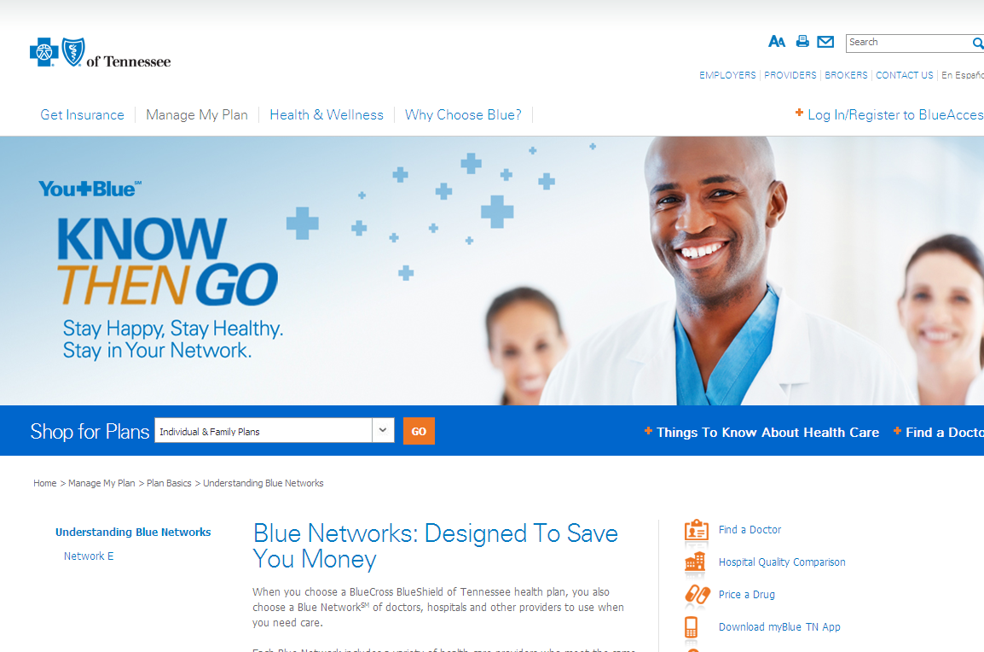
Education Campaigns
Health Insurance Marketplace
Marketplace resources for providers
  www.bcbst.com/providers/health-insurance-marketplace.page
Know Then Go
  Highlights the importance of understanding provider networks and the associated potential costs savings
Phone Support
  Help a client:
  1-888-257-0996
  For providers:
  1-800-924-7141
  For members:
  1-800-565-9140
Health Insurance Marketplace > Education Campaigns
23
Notes:
Key Points:
We are here to help. TONS of Marketplace resources available to you on the provider page of bcbst.com/providers, including a link to a comprehensive provider guide on the Marketplace.
We also have several key education campaigns designed to help our members understand the importance of seeking in-network care (Know Then Go)
And we have several phone options should you need support with navigator questions, provider questions, or member questions

Slide 17
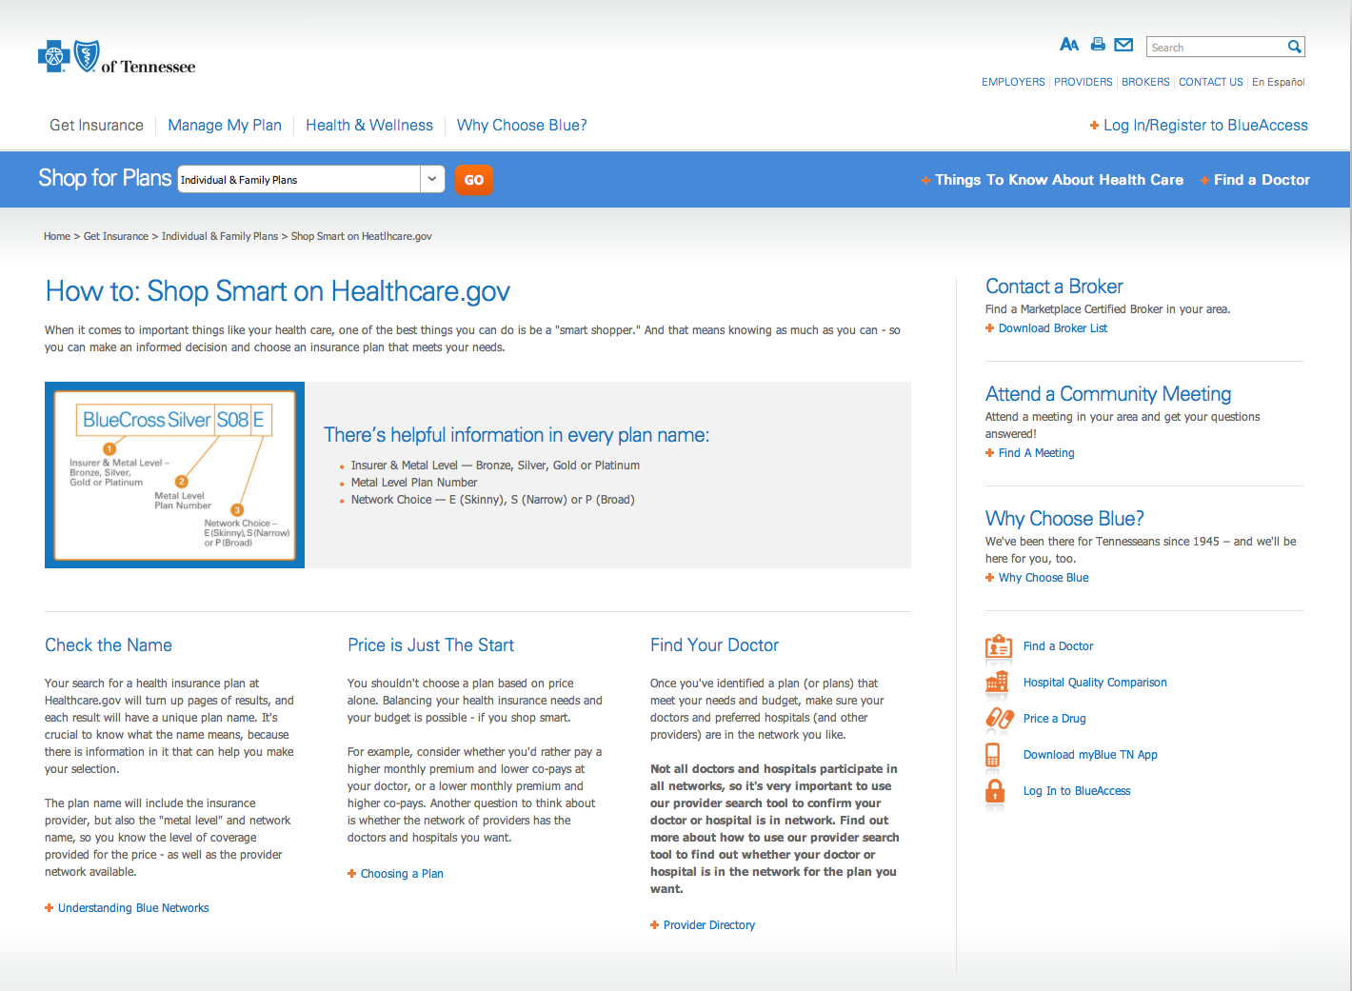
Education Campaigns
Health Insurance Marketplace
Shop Smart
  Online education at bcbst.com/knownow
  – Find list of FFM*-certified brokers appointed by BlueCross
  – Locate community meetings
  – Get information about instant quotes and subsidy calculations
  – View animated videos
*Federally Facilitated Marketplace
Health Insurance Marketplace > Education Campaigns
24
Notes:
Key Points:
Another education campaign helps our members learn how to shop for the right health insurance (Shop Smart)
Find certified brokers, locate a community meeting, get instant quotes, view helpful videos

Slide 18
What to Expect in 2015
Health Insurance Marketplace
More competition statewide with health plan issuers (Community Health Alliance and Assurant) extending coverage in more regions across the state; BlueCross was the only Qualified Health Plan (QHP) in 2014 to offer plans in every region
New QHP’s in the market (Assurant)
Rate adjustments
New plan offerings by BlueCross and other QHP’s
Health Insurance Marketplace > What to Expect in 2015
25
Notes:
Key Points:
New competition
More plans offering statewide coverage
Pricing changes (Note: our rate filing has not yet been approved by the state; refer to rate filing talking points for additional detail)
We’re offering a new bronze and a new silver plan to meet our market needs

